Slide 1
Formal Verification of AHB-to-APB Bridge
Yelin Mao, Yuxiang Xia, Hongkuan Yu
UNI: ym3000, yx2821, hy2819
Fall 2024

Slide 2
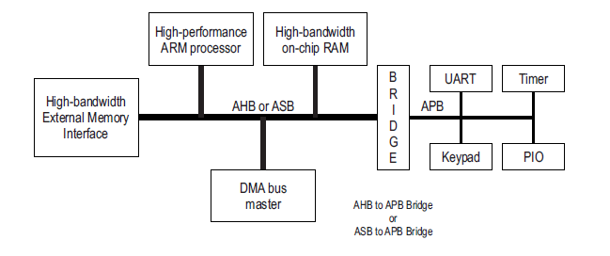

Introduction
Project Overview:
Formal verification of the AHB-to-APB bridge
Communication between the high-performance AHB and low-power APB buses
Verification Tools:
Using SystemVerilog Assertions (SVA)
Cadence Jasper Gold
Siemens Modelsim
‹#› | Formal Verification of AHB-to-APB Bridge

Slide 3
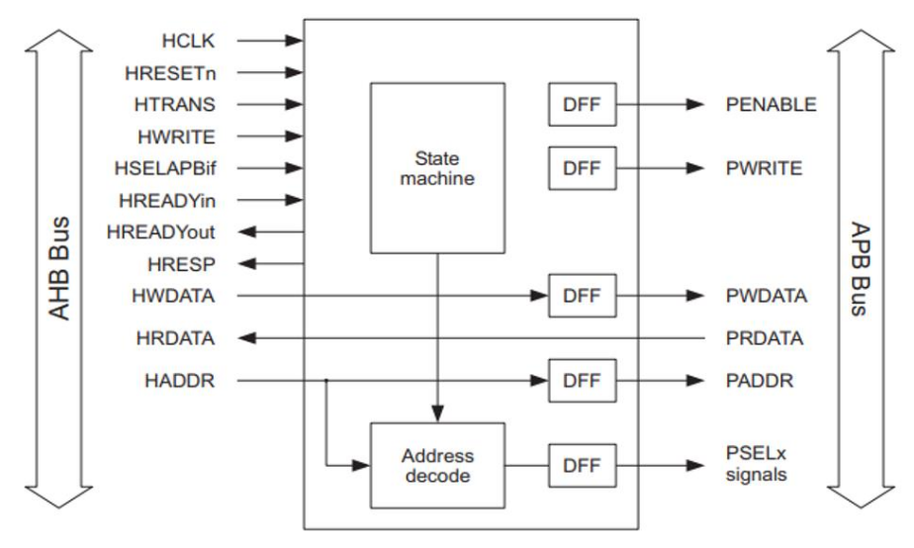
Structure
Three components:
AHB_Interface
Manages AHB bus communication
APB_FSM
Controls APB data transfer via an independent finite state machine
TOP
Integrates AHB and APB components for seamless communication
I/O Ports
‹#› | Formal Verification of AHB-to-APB Bridge

Slide 4
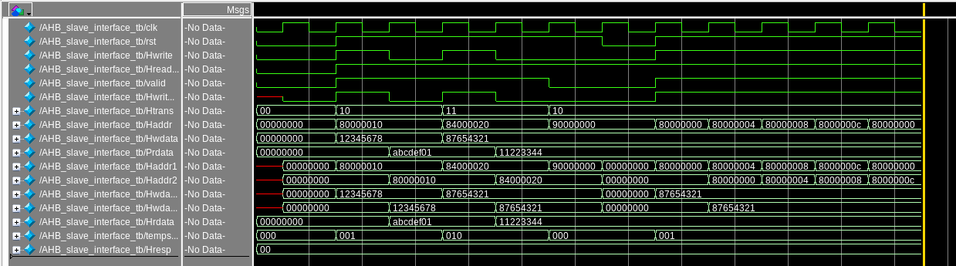
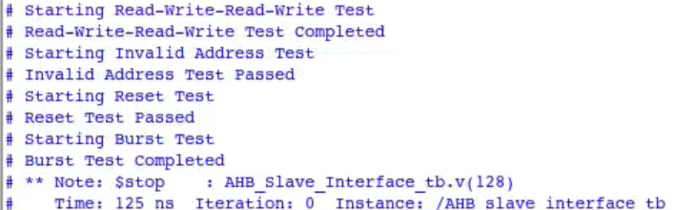
Stimulation - AHB Interface
Read-Write-Read-Write
Invalid Address
Reset
Burst Write
Expected outputs
‹#› | Formal Verification of AHB-to-APB Bridge

Slide 5
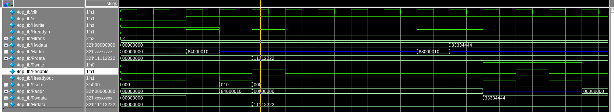
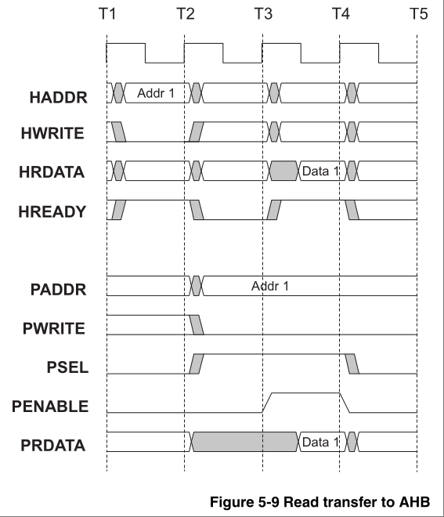
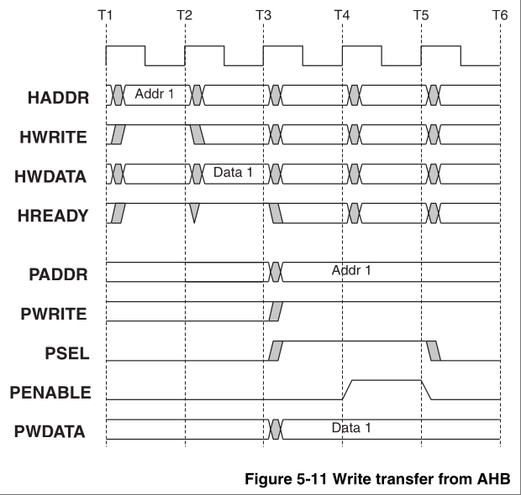
Stimulation - TOP
Single read & write
Expected outputs except Pslex
‹#› | Formal Verification of AHB-to-APB Bridge

Slide 6
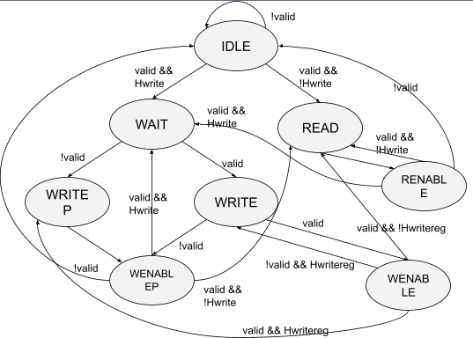
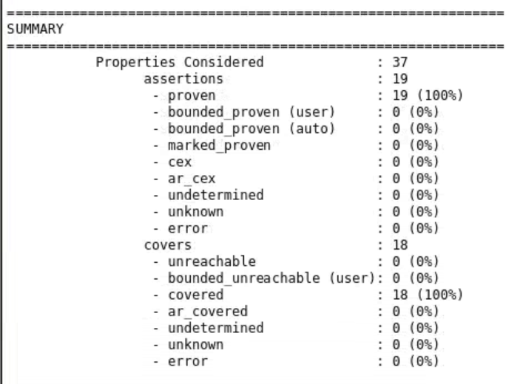
SVA - FSM
States: IDLE, WAIT, READ, WRITE, WRITEP, WENABLE, WENABLEP, RENALE
Transitions based on inputs (valid, Hwrite, Hwritereg)
‹#› | Formal Verification of AHB-to-APB Bridge

Slide 7
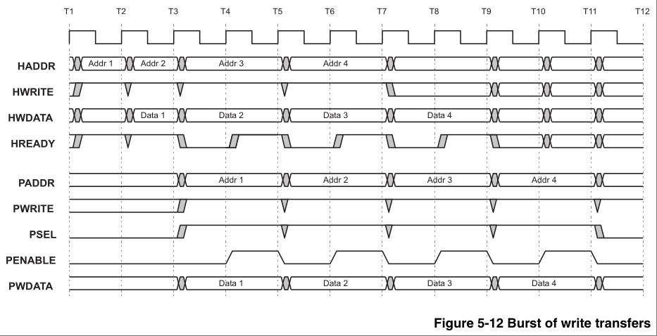
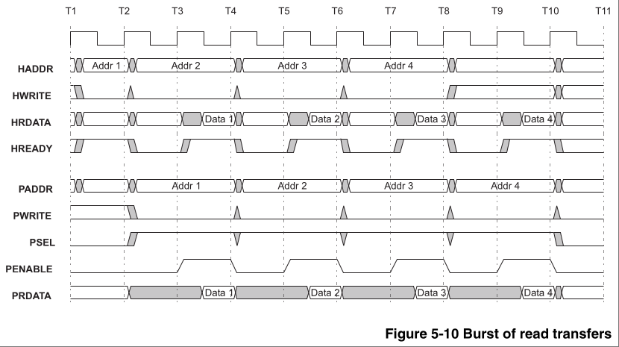
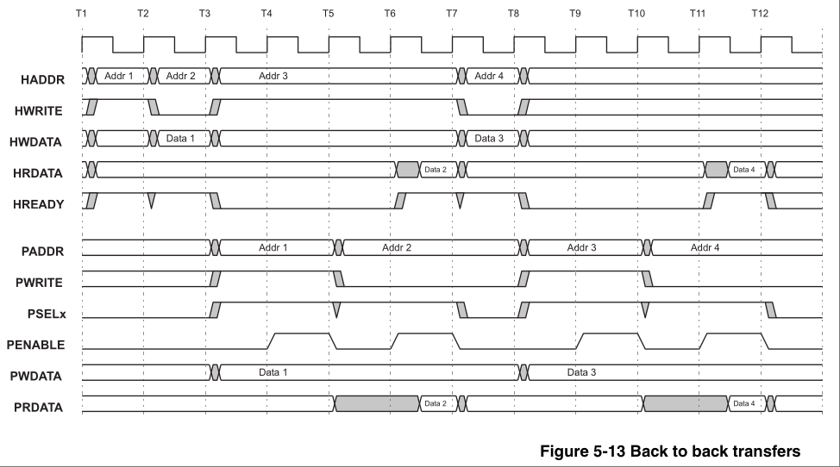
Property Verification
Five Scenarios:
Single Write
Single Read
Burst write
Burst read
Back to back
‹#› | Formal Verification of AHB-to-APB Bridge

Slide 8
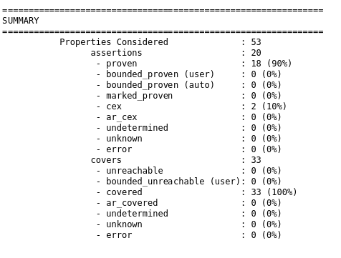
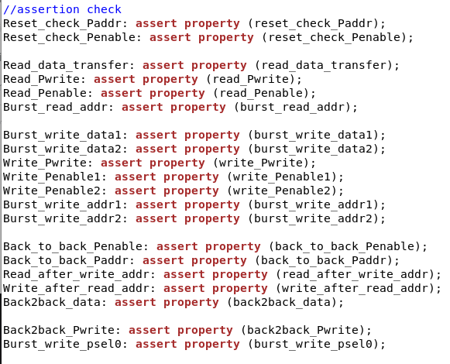
Property Verification
Input signal timing constraints
Hwrite Hwdata
Hreadyin Prdata
Haddr
Output check:
Pwrite Pwdata
Paddr Hrdata
Penable Pselx
Assumptions:
-valid input address
-transfer type
-burst read constraint
-burst write constraint
-back to back constraint
‹#› | Formal Verification of AHB-to-APB Bridge

Slide 9
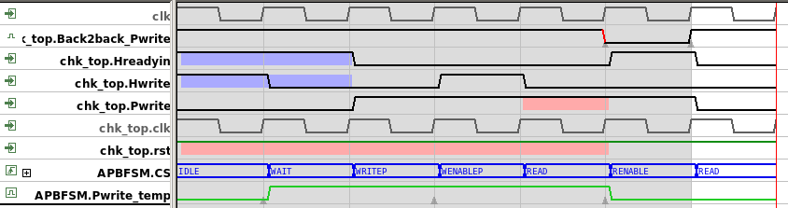
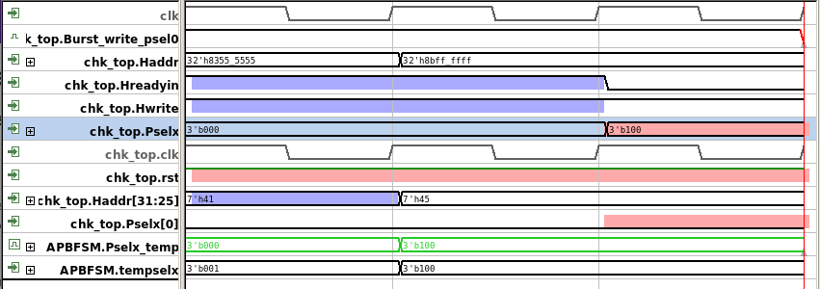
SVA - TOP
All passed except:
Back2back_Pwrite:
Sequence: write → read → invalid → invalid → invalid
First and second cycles: back-to-back transfers
Error: Pwrite incorrectly high at the fifth cycle
Expected: Pwrite should match Hwrite from the second cycle (low)
Caused by insufficient RTL design
Brust_write_psel0:
Error: Pselx should be 3’b001
3’b100 should occur at the fifth cycle
Pselx does not transfer correctly in the original RTL FSM code
‹#› | Formal Verification of AHB-to-APB Bridge

Slide 10
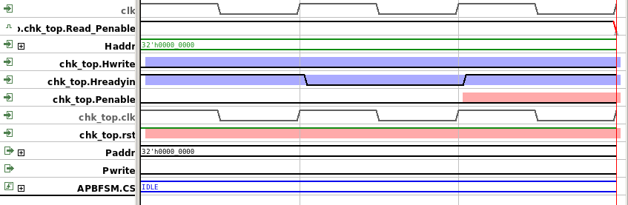
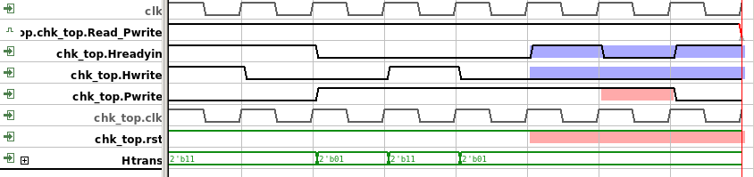
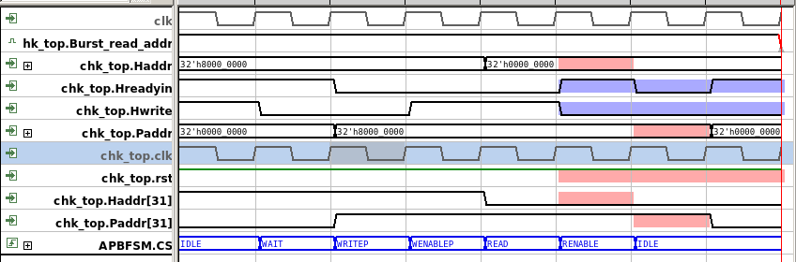
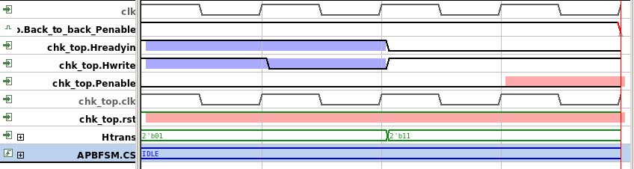
SVA - TOP Counterexample Analysis
read_Penable
Removing valid address range assumption:
State machine remains in the IDLE state due to invalid address
Burst_read_addr
read_Pwrite
Removing transfer type assumption:
Htrans in Busy mode causes the state to remain in the IDLE state
Back_to_back_Penable
‹#› | Formal Verification of AHB-to-APB Bridge

Slide 11
Stimulation vs SVA
Stimulation:
Verified single write/read and identified the Pselx error
Unable to fully check burst read/write scenarios and back-to-back transfers
SVA:
More effective in verifying burst read/write and complex state transitions
Captured issues like incorrect Pwrite behavior during back-to-back transfers, which were missed in stimulation
‹#› | Formal Verification of AHB-to-APB Bridge

Slide 12
Conclusion & Future Work
Conclusion:
Formal verification of the AHB-to-APB bridge confirmed correct data transfer.
Identified and addressed issues in state transitions and address handling in the RTL code.
Future Work:
Fix identified errors in the RTL code.
Expand verification to cover more scenarios and edge cases.
Optimize tool integration and extend verification to other AMBA components.
‹#› | Formal Verification of AHB-to-APB Bridge

